Slide 1
Network Sandbox
Creating a Secured Test Environment
Maria Isabel German • Kamaldeep Kaur • Achu Mary Philip
October 26, 2024

Slide 2
What is Sandbox
A fundamental security technique in information technology, designed to strengthen system protection against a wide range of threats.
Involves creating an isolated environment where applications, web browsers, or specific code segments can operate safely without affecting other system parts.
Similar to a child's sandbox in a playground, where play activities are confined within defined boundaries, preventing any disruption to the surrounding environment.

Slide 3
Types of Sandboxing
Each app runs in its isolated environment with specific permissions, preventing it from accessing resources or data without consent.
Isolation is done for web content, JavaScript execution, and plugins to ensure that malicious web content does not harm user’s system.
Instead of running the sandbox on local hardware, the suspicious or untrusted code is executed in a virtual environment provided by a cloud infrastructure or virtual machine (VM).
These are isolated environments used by developers to code, test and debug new software features or configurations without affecting the production environment or live data
Facilitates thorough examination and assessment of a suspicious code, malware, or unknown threats without risking the host system or network
Provides an additional layer of defense by analyzing traffic and detecting threats like viruses, worms, or other malware before they infiltrate the network.
Application Sandboxing
Browser
Sandboxing
Cloud-based / Virtual Sandboxing
Developer Sandboxing
Security
Sandboxing
Network Sandboxing
Notes:
In computing, sandboxing enables the secure execution and testing of untrusted programs or code by limiting their access to system resources and data. This isolation is crucial for preventing the spread of hidden malware, protecting sensitive information like personal data, and ensuring overall system integrity. By confining actions and permissions to only what is absolutely necessary, digital sandboxing reduces the risk of security breaches and system damage, making it an essential component of contemporary cybersecurity strategies.
Application Sandboxing: Commonly used in operating systems and mobile apps to restrict access to system resources and data, preventing the application from affecting the overall system.
Examples:
Mobile OSes like iOS and Android run applications within a sandbox to prevent them from accessing unauthorized system resources and user data.
Operating system functionality like Seccomp, groups, and Linux namespaces from the kernel features in Linux; Apple App sandbox is available for Mac and required for all applications distributed via Mac Store; Windows has an inbuilt sandbox for pro-version users.
Browser Sandboxing: Utilized to prevent web-based code from affecting the rest of the system. Each website or tab operates in a separate sandbox, ensuring malicious websites or downloads do not compromise the user’s computer.
Cloud-based/Virtual Sandboxing: Offers the flexibility of testing and analyzing threats without relying on physical hardware resources. Using virtualization technology, these sandboxes provide a completely isolated operating system environment in which you can run programs, watch their behavior, and analyze their performance without risking the host OS.
Cloud providers offer sandbox environments where you can experiment with different cloud services. These sandboxes allow for the deployment and testing of applications in the cloud without incurring the costs or risks associated with a production environment.
Developer Sandboxing: enables developers to write and test code in an isolated environment, preventing potential errors or untested code from impacting the live production environment. They are a form of virtual environment or sometimes a full virtual machine where the software or applications under development can be securely tested.
Security Sandboxing: Proactive strategy for identifying and addressing potential security risks.
Often found in antivirus programs and intrusion prevention systems where potential malware can be executed harmlessly to analyze its behavior.
Network sandboxing: Helps conduct advanced malware analysis by allowing suspicious files to execute in a segregated environment that simulates a real end-user operating system. Network sandboxes monitor network traffic for suspicious objects and automatically submit them to the sandbox environment, where they are analyzed and assigned malware probability scores and severity ratings. Sandboxing technology has been used for years by malware researchers at security companies and even in some large enterprises that are highly security conscious.
In this presentation, we will focus on Network sandbox

Slide 4
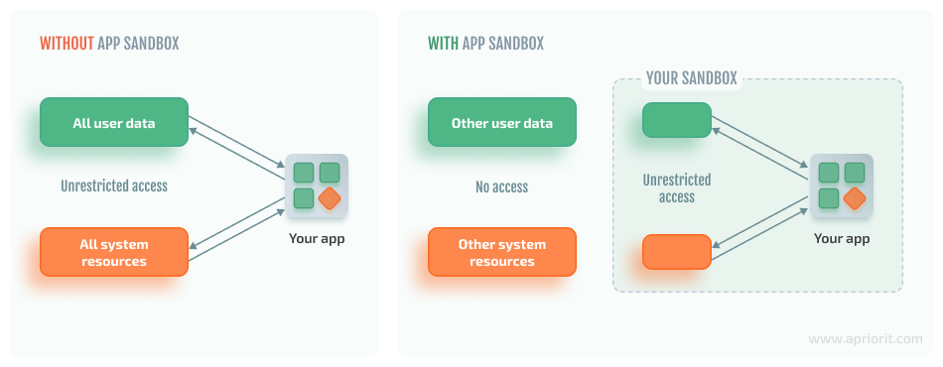
With or Without Sandbox?
Corporate networks and computers directly connected to the internet are prone to attacks and damages from illegal access from the outside.
Malicious mobile codes (Active X, Java, VB Script as well as other executable files) are increasingly being used to issue attacks. Without sophisticated knowledge, the rates of these threats increases enormously.
Notes:
Without sandbox, an environment is prone to various attacks and these problems can be addressed thru sandboxing.

Slide 5
Sandbox: Additional Layer of Security
Sandboxing offers significant security benefits that enhance an organization’s defense against both known and unknown threats.
Enhanced Security: Running suspicious code in a sandbox minimizes security breach risks and protects valuable data.
Protection Against Unknown Threats: Effectively prevent unknown threats and advanced malware that might evade standard detection methods, safeguarding against zero-day attacks.
Actionable Intelligence: Provides valuable insights that help organizations develop clear threat profiles, aiding in the prevention of future threats.
Notes:
Protection Against Unknown Threats: Using a sandbox is a reliable method for preventing unknown threats or advanced malware that evade straightforward detection methods. Zero-day threats can escape signature-based detection mechanisms, so triggering them in a safe and isolated environment protects organizations from catastrophic attacks.
Better Actionable Intelligence: Knowledge is power, and sandbox testing offers a treasure trove of actionable intelligence that enables organizations to create a clear threat profile, which will be extremely useful for preventing future similar threats.

Slide 6
Benefits of a Network Sandbox
Test Applications: Run new or untested applications safely to observe their behavior without risking the main network.
Analyze Malware: Execute potentially harmful software in a controlled environment to study its effects and understand its behavior.
Experiment with Network Configurations: Test network setups, protocols, and configurations without impacting the live environment.
Develop Security Measures: Simulate attacks or vulnerabilities to assess and enhance network security strategies.
Notes:
Sandbox allows developers, security researchers, and system administrators to maximize these features. By providing a contained space, a network sandbox helps ensure that any risks associated with testing or experimentation do not compromise the overall network integrity. It also enables an organization to take a proactive approach and perform detailed analyses, thereby assisting teams in assessing their security controls and enhancing overall cybersecurity posture.
Test Applications: Helps identifying and analyzing threats leading to better understanding and more effective countermeasures.
Analyze Malware: By isolating suspicious code, sandboxing can help analyze the impact of suspicious code and reduce the risk of system-wide compromises. It can also aid in tracing the source or nature of an attack, as well as the remediation and prevention of future attacks.
Experiment with Network Configurations: When made a part of network intrusion detection systems and intrusion prevention systems (IDS/IPS), sandboxing can tell these systems which connections to block, adding an additional layer of security.
Develop Security Measures: Sandboxing contributes to the early detection of threats, enabling swift mitigation before extensive damage occurs. The data collected through sandbox investigations can be used for proactive threat hunting, enhancing an organization's security posture by looking for potentially missed threat events.

Slide 7
Key Features of Network Sandbox
Traffic Isolation: Suspicious network traffic can be redirected to a sandboxed environment, preventing it from spreading or causing harm to the main network.
Threat Analysis: Enables security teams to analyze malware, exploits, and other threats in a safe environment, helping to understand their behavior and impact.
Real-time Monitoring: Can monitor how malicious code interacts with the network, providing insights that aid in developing effective security measures.

Slide 8
Key Features of Network Sandbox
Testing New Solutions: Organizations can use network sandboxes to test new security solutions or configurations without risking disruption to existing operations.
Enhanced Security Posture: By identifying and mitigating threats in a controlled setting, network sandboxing contributes to a stronger overall security posture.

Slide 9
Setting up a Network Sandbox
A step-by-step guide

Slide 10
Step 1: Choose Your Environment
To choose the right sandbox environment, consider your purpose - malware analysis, testing, or secure browsing - along with operating system compatibility, isolation level, ease of use, and performance impact on the host system.
Security features, community support, and tool compatibility are crucial.
Consider resource requirements, costs (for commercial solutions), customization options, update frequency, and user feedback.
Make a decision that aligns with your specific goals, ensuring it meets your needs while balancing security and usability.
Testing and experimenting with different sandboxes can help you find the best fit for your requirements.
Notes:
Isolation is key, determine the level of separation needed to protect your main system while allowing for accurate testing. Performance impact is also vital so choose an environment that won’t degrade your host system’s performance. Security features should be robust, incorporating firewalls, intrusion detection, and encryption to safeguard against potential threats.

Slide 11
Sandbox Environment: Physical vs. Virtual
Physical (Hardware) Sandbox
Virtual (Software) Sandbox
Physical devices or systems dedicated to sandboxing. They can be used for more stringent isolation but are often more resource-intensive.
Provides complete isolation from the main network and systems, enhancing security.
Allows for direct interaction with hardware, making it suitable for hardware-specific testing.
Slower setup and scaling processes compared to virtual environments.
Higher costs due to the need for purchasing and maintaining dedicated hardware.
Virtualized environments that can be set up using software tools. Popular options include VirtualBox, VMware, Docker, and Kubernetes.
More cost-effective, as multiple virtual instances can run on a single physical machine.
Quick to deploy and scale, making it easier to adapt to changing testing needs.
Offers flexibility to run different operating systems and configurations without dedicated hardware.
Security depends on proper configuration to mitigate vulnerabilities in the hypervisor or host system.
Notes:
For this project, we have chosen Virtual Sandbox environment, particularly VirtualBox, to leverage flexibility, resource efficiency and cost effectiveness.

Slide 12
Advantages of VirtualBox
Cross-Platform Compatibility | Offers compatibility with various supported host operating systems, including Windows, macOS, Linux, and Oracle Solaris.
Testing and disaster recovery | Once installed, a virtual machine and its virtual hard disks act as a container that can be frozen, woken up, copied, backed up, and moved between hosts.
Infrastructure consolidation | Virtualization can significantly reduce hardware and electricity costs.
Open Source | It is freely available for personal and commercial use, enabling users to run virtual machines without complex configuration or hardware changes.
Powerful Snapshot and Cloning Features | Offers robust snapshot and cloning capabilities, allowing users to capture the current state of a virtual machine and revert to it at any point.
Extensive Guest OS Support | Supports various guest operating systems, ranging from multiple versions of Windows and Linux distributions to macOS, BSD*, and more.
User-Friendly Interface | The GUI makes it accessible to users with varying levels of technical expertise, while advanced users can also take advantage of the command-line interface for more granular control.
Notes:
Infrastructure consolidation: Most of the time, computers today only use a fraction of their potential power and run with low average system loads. A lot of hardware resources as well as electricity is thereby wasted. So, instead of running many such physical computers that are only partially used, one can pack many virtual machines onto a few powerful hosts and balance the loads between them.
Powerful Snapshot and Cloning Features: This feature is invaluable for testing and development scenarios, enabling users to experiment freely without fearing damaging the original setup. Cloning facilitates the rapid deployment of identical virtual machines, saving time in setting up similar technical environments.
*BSD: The Berkeley Software Distribution (BSD) is a discontinued operating system derived from Research Unix, developed by the Computer Systems Research Group (CSRG) at the University of California, Berkeley; the term “BSD” now commonly refers to its open-source descendants, including FreeBSD, OpenBSD, NetBSD, and DragonFly BSD.

Slide 13
Step 2: Install Virtualization Software
Download VirtualBox: Visit the official website and download the installer compatible with your OS (Windows, macOS, Linux).
Run the Installer and follow the wizard: Locate the downloaded file and initiate the installation process. Select additional components like VirtualBox Networking if needed.
Complete Installation: Wait for the installation to finish, which may include installing device drivers for virtual network interfaces.
Notes:
Device Driver: They are software that control particular hardware and tell other software or the operating system how to communicate with it. In this case, the drivers allow the host OS to manage and interact with the virtual network interfaces created by VirtualBox.

Slide 14
Step 3: Create Virtual Machines
Create a VM: Name and Operating System
Name: Choose an informative name for your new VM, as this will appear in the VirtualBox Manager and be used for its files on disk. For clarity, include the OS and software, such as "Windows 10 with Visio."
ISO Image. Select an ISO image file. The image file can be used to install an OS on the new virtual machine, or it can be attached to a DVD drive on the new virtual machine.
Type and Version: These fields let you select the OS for your new VM, grouped by type.
Notes:
Type and Version: If you want to install something very unusual that is not listed, select the “Other” type. Depending on your selection, Oracle VM VirtualBox will enable or disable certain VM settings that your guest OS may require. This is particularly important for 64-bit guests. It is therefore recommended to always set this field to the correct value. If an ISO image is selected and Oracle VM VirtualBox detects the operating system for the ISO, the Type and Version fields are populated automatically and are disabled.
Unattended guest OS installation enables you to install the OS on a virtual machine automatically.

Slide 15
Create a VM: Hardware
Base Memory: Select the amount of RAM that Oracle VM VirtualBox should allocate every time the virtual machine is started.
Processor(s). Select the number of virtual processors to assign to the VM.
Enable EFI. Enables Extensible Firmware Interface (EFI) booting for the guest OS.
Notes:
Base memory: The amount of memory selected here will be taken away from your host machine and presented to the guest OS, which will report this size as the virtual machines installed RAM. The memory you give to the VM will not be available to your host OS while the VM is running, so do not specify more than you can spare. On the other hand, you should specify as much as your guest OS and your applications will require to run properly. A guest OS may require at least 1 or 2 GB of memory to install and boot up. For best performance, more memory than that may be required.
Processor: It is not advised to assign more than half of the total processor threads from the host machine.

Slide 16
Create a VM: Virtual Hard Disk
Create a Virtual Hard Disk Now: Creates a new empty virtual hard disk image, located in the VM's machine folder.
Use an Existing Hard Disk File: Enables you to select an existing disk image file to use with the new VM. The drop-down list shows all disk images recognized by Oracle VM VirtualBox, including those currently or previously attached to a VM.
Do Not Add a Virtual Hard Disk: The new VM is created without a hard disk.
Notes:
To prevent your physical hard disk on the host OS from filling up, Oracle VM VirtualBox limits the size of the image file. But the image file must be large enough to hold the contents of the guest OS and the applications you want to install. For a Windows or Linux guest, you will probably need several gigabytes for any serious use. The limit of the image file size can be changed later.
You can skip attaching a virtual hard disk file to the new virtual machine you are creating. But you will then need to attach a hard disk later, to install a guest operating system.

Slide 17
Step 4: Network Configuration
Network Modes
NAT (Network Address Translation): allows a VM to access external networks, like the internet, while being isolated from the host and other devices on the local network.
NAT Network: enables multiple virtual machines to communicate with each other while still accessing external networks.
Bridged Adapter: mode is used for connecting the virtual network adapter of a VM to a physical network to which a physical network adapter of the VirtualBox host machine is connected.
Notes:
VirtualBox provides a long list of network modes, which is one of the most interesting features of VirtualBox network settings. Each virtual network adapter can be separately configured to operate in a different network mode. For example, you can set the NAT mode for the adapter 1 and the Host-only mode for the adapter 2 (Screenshot for reference on next slide).
NAT: By default, this network mode is enabled for virtual network adapters, allowing the guest OS on a VM to access the local area network (LAN) and external networks, including the internet, through a virtual NAT device. However, the guest machine is inaccessible from the host or other network machines, making it ideal for users needing only internet access.
NAT Network: This mode creates a private network shared by VMs, allowing them to interact internally while maintaining NAT for external access.
Bridged: A VM virtual network adapter uses the host network interface for a network connection. Put simply, network packets are sent and received directly from/to the virtual network adapter without additional routing. A special net filter driver is used by VirtualBox for a bridged network mode in order to filter data from the physical network adapter of the host. This network mode can be used to run servers on VMs that must be fully accessible from a physical local area network.

Slide 18
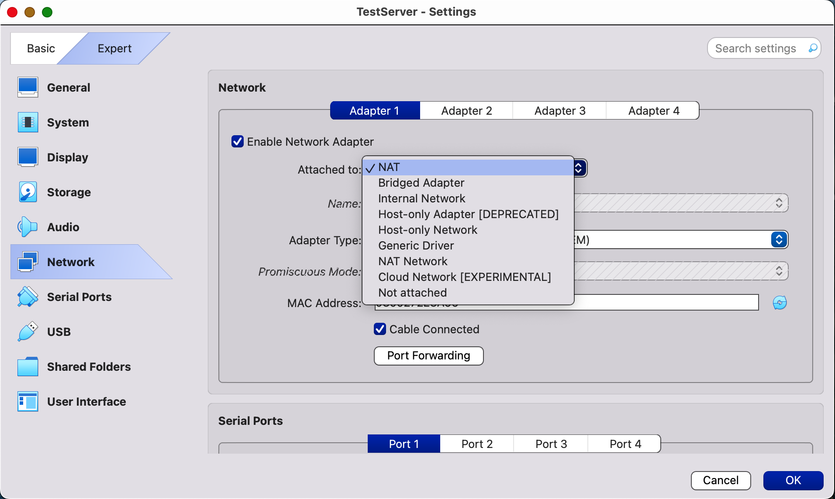
Network Modes
Host-Only Adapter: mode is used for communicating between a host and guests. A VM can communicate with other VMs connected to the host-only network, and with the host machine. The VirtualBox host machine can access all VMs connected to the host-only network.

Slide 19
Network Modes
Internal Network: VMs configured for this mode connect to an isolated virtual network, allowing communication only between VMs. They cannot communicate with the host machine or any external networks.
Generic Driver: allows you to share the generic network interface. A user can select the appropriate driver to be distributed in an extension pack or be included with VirtualBox.
Not Attached: the virtual machine's network adapter is disabled, meaning it cannot connect to any networks.
Notes:
Internal Network: This mode is useful for modeling real networks, as VMs cannot be accessed from the host or other devices.
Not Attached: his mode is useful when you want to isolate the VM completely, preventing any network communication. It is often used for testing purposes or when network access is unnecessary.

Slide 20
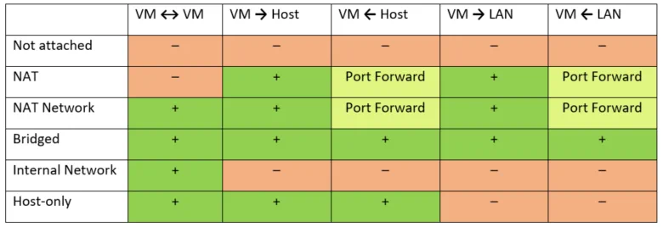
Comparison of VirtualBox Network Modes
Notes:
Port forwarding is a process of intercepting traffic addressed to the appropriate IP address and port in addition to redirecting that traffic to a different IP address and/or port. By creating port forwarding rules, you can map a port on the host to a port on the VM. When a request is made to the specified host port, it is forwarded to the corresponding VM port.

Slide 21
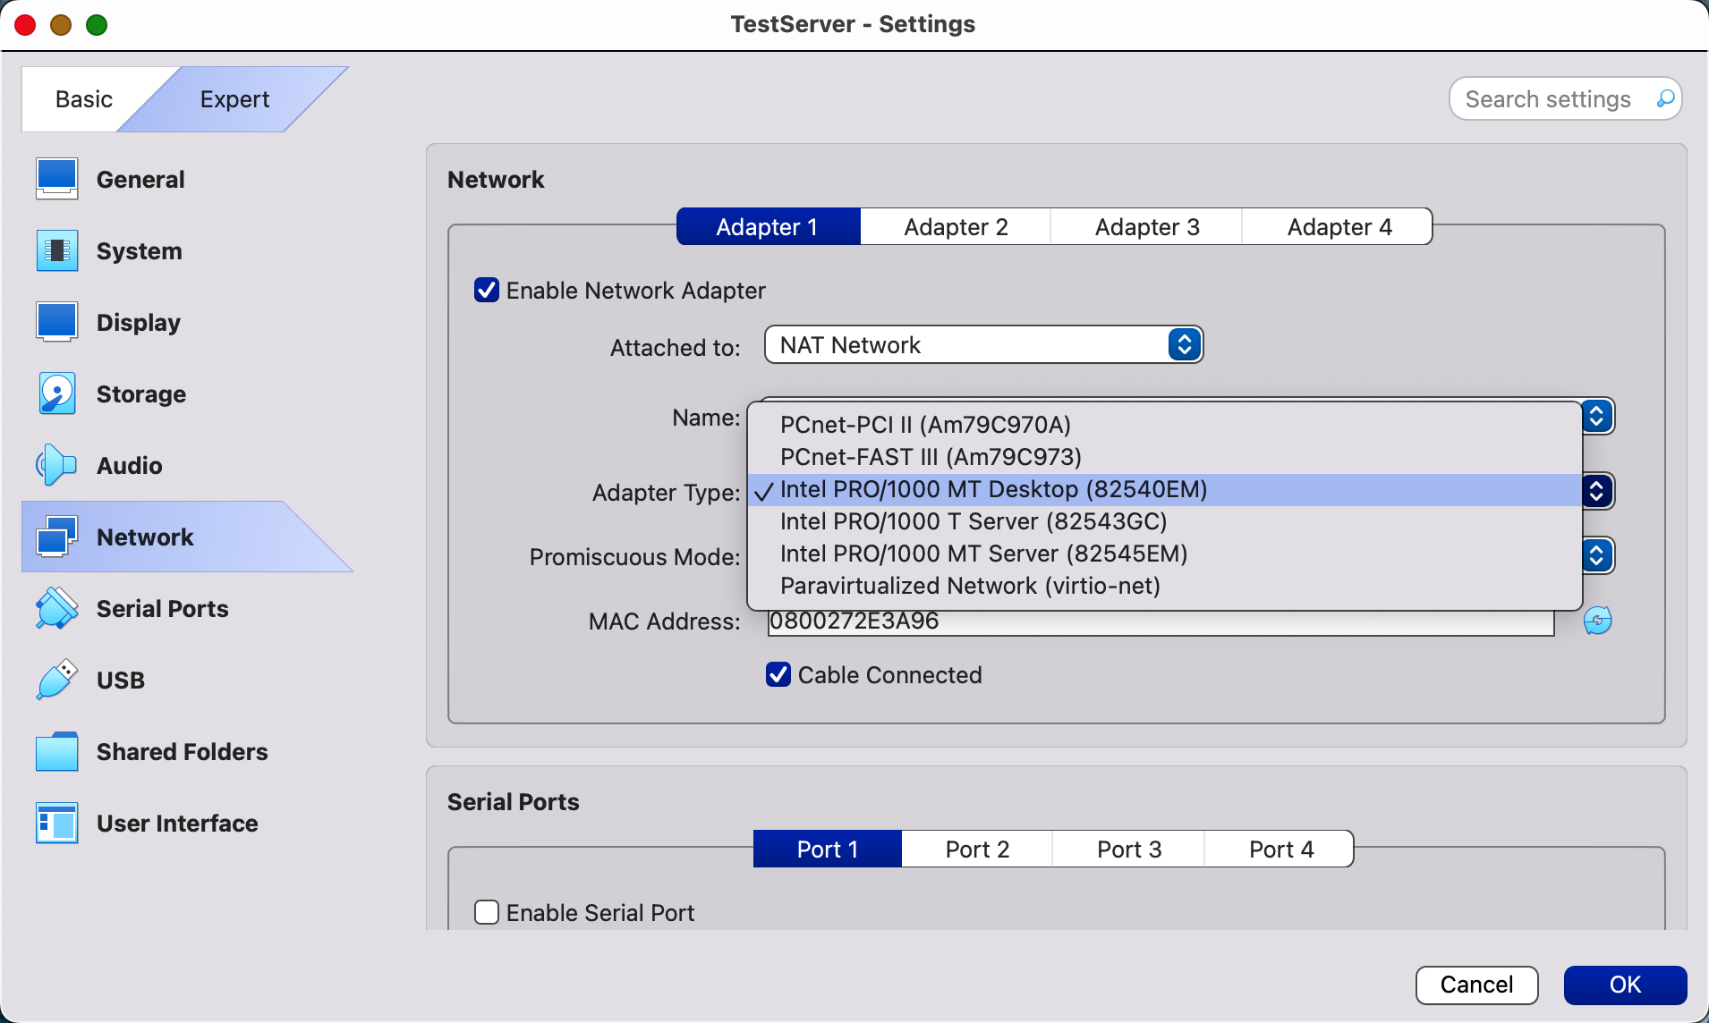
Network Adapter Types (Emulated Hardware)
PCnet-PCI II (Am79C970A): This is based on AMD technology and is suitable for various situations. It works well with older Windows versions (like Windows 2000), but newer versions (such as Windows 7, 8, and 10) lack built-in drivers for it.
Notes:
The Am79C970A PCI device originally featured a 10-Mbit controller with an integrated DMA engine and supports AMD’s Magic Packet technology for remote wake-up.

Slide 22
Network Adapter Types (Emulated Hardware)
PCnet-FAST III (Am79C973): This virtualized network adapter is supported by almost all guest operating systems that can run on VirtualBox. GRUB (the boot loader) can use this adapter for network boot. Similarly to the previous network adapter, this one is based AMD chip.
Intel PRO/1000 MT Desktop (82540EM): This adapter works perfectly with Windows Vista and newer Windows versions. The most of Linux distributions support this adapter as well.
Intel PRO/1000 T Server (82543GC): Windows XP recognizes this adapter without installing additional drivers.

Slide 23
Network Adapter Types (Emulated Hardware)
Intel PRO/1000 MT Server (82545EM): This adapter model is useful to import OVF templates from other platforms and can facilitate import process.
Paravirtualized Network Adapter (virtio-net): is a special case. Instead of virtualizing networking hardware that is supported by most operating systems, a guest operating system must provide a special software interface for virtualized environments. This approach allows you to avoid the complexity of networking hardware emulating and, as a result, can improve network performance.

Slide 24
Step 5: Install Required Software
Network Monitoring Tools
The landscape of network monitoring tools is vast, as it offers a multitude of options to choose from. By categorizing tools, you can make informed decisions on which ones to install and configure within your VM, enhancing your sandbox's effectiveness.

Slide 25
Type | Primary Use | Example Tools
SNMP | Network device monitoring as it report the status and performance of network devices, such as routers and firewalls. | SolarWinds Network Performance Monitor, Zabbix, ManageEngine OpManager, Paessler PRTG, Nagios
Passive | Essential for analyzing traffic patterns and detecting any anomalies without interfering with the sandbox operations. | Wireshark, tcpdump, Snort, Suricata
Active | Used for testing how your network behaves under different conditions and ensuring services are responsive. | Ping Tools
Notes:
SNMP - Simple Network Management Protocol

Slide 26
Limitations of Sandboxing
The Rising Challenge of Sandbox Evasion

Slide 27
Limitations of Sandboxing
Network sandboxes are valuable for testing and analyzing network behavior, but they do have several limitations:
Performance Overhead & Scalability: Can lead to significant performance overhead due to the resources required for virtualization. Also, sandboxing is often used as an add-on in broader systems.
High Complexity: Setting up and maintaining sandbox environments can be complex and resource-intensive, requiring organizations to have the
necessary expertise to manage them effectively.
Evasion Techniques: Malware developers continually create methods to evade detection in sandbox environments making sandbox security a critical consideration.
Notes:
Performance Overhead & Scalability: One of the primary limitations of sandboxing is the overhead performance associated with virtualization. Running applications in a sandbox may require additional resources, resulting in slower execution times. It is typically impractical to sandbox every file in an environment without a significant infrastructure. Therefore, sandboxing is usually integrated as an add-on technology within a broader processing funnel.
High Complexity: The concept of sandboxing seems simple enough and effective, but it’s barely keeping up. Organizations need "protection without disruption," something sandboxing is unable to provide because it’s complex and time-consuming. Traditionally, using a sandbox has been an intensive effort requiring advanced skills. The malware researcher manually submits a suspicious object into the sandbox and analyzes it before flagging it as malware or not. Analyzing file behavior in a sandbox requires malware analysis and operating system expertise on the part of security analysts and modern enterprises can’t afford that kind of delay.
Evasion Techniques: Sandboxes don’t always work. Sophisticated cyberattacks are known to detect and evade sandboxing. Even some known and outdated malware attacks have evolved and reemerged with variants that can circumvent sandboxing techniques. For instance, a variant of the Emotet malware masks its file type with a .doc extension. Since sandboxing relies on true filetypes, it doesn’t consider it an executable and opens it in a Word document instead. Modern malware also analyzes the hardware, installed applications, network connectivity, patterns of mouse clicks and open and saved files to gauge if it’s in a sandbox environment. The malware will delay execution if it detects a sandbox. Therefore, security analysts won’t find any malicious file behavior and will deem the malware-infected files safe. By identifying that they are running in a sandbox environment, these suspicious programs can alter their behavior or delay the execution to bypass analysis and detection.

Slide 28
Sandbox Evasion Techniques
Detect user actions like mouse clicks and document scrolling
Verify real-life environment characteristics such as Geolocation and Geo-blocking, Identifying Physical Markers, and
Querying Network Information
Trick the sandbox by changing DNS names, encrypting API calls or even display manipulation
Looking for system characteristics like registry, CPU and memory usage
Notes:
Here are the common sandbox evasion techniques. On the next slides we will discuss it further and its limitations.

Slide 29
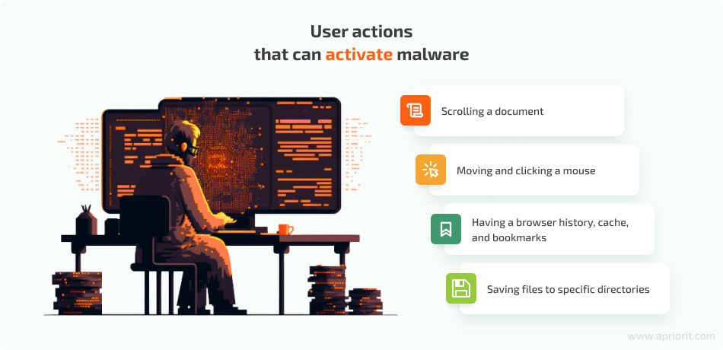
User Interactions Evasion
Users interact with computers in different ways, but sandbox environments often lack human-like interactions. As a result, hackers can design malware to wait for specific user actions before activating its malicious behavior.
Notes:
Here are some examples of sandbox detection techniques that depend on user interactions:
Scrolling a Document: Modern malware can be programmed to activate only when a user scrolls to a specific point in a document. For example, malware embedded in Microsoft Word documents may use special paragraph codes to detect scrolling. Since sandbox environments lack scroll movements, the malware can remain dormant.
Moving and Clicking a Mouse: Some malware checks the speed of mouse movements and clicks, staying inactive if the movements are suspiciously fast or if there aren’t enough clicks. It may also require specific user actions to trigger its execution.
Browser History, Cache, and Bookmarks: A real user who browses the internet regularly will have a history, cache, and bookmarks saved on their machine. In contrast, a sandbox environment frequently clears the browsing cache to eliminate potential malware, leaving it devoid of this information. Malware can check for these elements and remain dormant if they are absent.
Saving Files to Specific Directories :Malware can verify whether a system allows saving custom files to locations like the desktop or root folder. While it's generally not recommended to save files in these directories, many real users do. Sandboxes typically avoid this practice, making it another indicator that can signal the presence of a sandbox environment.

Slide 30
Limitations: User Interactions Evasion
Detection Mechanisms: Many sandboxes are evolving to better simulate user interactions, making it increasingly difficult for malware to rely on evasion tactics.
Environmental Differences: Malware that depends on specific user interactions may not perform as expected in varied real-world environments, leading to potential execution failures
User Behavior Variability: The wide range of user interactions makes it challenging for malware to consistently predict and exploit specific actions, which can result in missed opportunities to execute malicious behavior.

Slide 31
System Checks Evasion
Process Enumeration: Utilize system calls to enumerate active processes. Look for processes like VBoxService (Virtual Box) or vmware-vmx.exe (Vmware).
Registry Checks: Query Windows Registry for entries indicating virtualization. Specific keys, like HKEY_LOCAL_MACHINE\SOFTWARE\Microsoft\Windows\CurrentVersion\Uninstall , may contain signs of Sandbox installations.
Environment Variable Inspection: Access environment variables for clues about the environment. Look for variables such as VIRTUAL_ENV or VIRTUAL BOX_HGCM
Network Configuration Checks: Examine network settings for unusual configurations typical of virtual environments. Check for multiple virtual adapters or specific IP ranges used by Sandboxes.
System Performance Metrics: Monitor CPU and memory usage. Sandboxes may exhibit different performance characteristics compared to physical machines.
Notes:
Assess the execution environment to identify if it is a Sandbox, enabling the malware to adjust its behavior accordingly.

Slide 32
Limitations: System Checks Evasion
Detection Risk: Advanced Sandboxes can log and monitor querying activities, potentially leading to detection and countermeasures.
False Positives: Legitimate environments might mimic Sandbox traits, causing misidentification and unnecessary evasive actions.
Dynamic Sandbox Techniques: Sandboxes constantly update their detection mechanisms, making traditional checks less reliable over time.
Implementation Complexity: Developing robust and comprehensive system checks can be technically complex and resource-intensive.
Environmental Variability: Rapid changes in IT infrastructures can lead to inconsistent results; a system's characteristics may change unexpectedly.
Evasion Method Limitations: Some evasion techniques can only be effective under specific conditions, making them situational and unreliable in diverse environments.

Slide 33
Environmental Awareness: Geolocation and Geo-blocking Evasion
Geolocation Filtering: This technique involves checking the geographic origin of the IP address executing the binary. By implementing a filter, attackers can determine if their payload is running in a Sandbox located in a different region, allowing them to avoid detection.
IP Spoofing: Attackers can spoof their IP addresses to make it appear as though they are accessing the target from a legitimate location. This can help bypass geo-blocking measures, but it may raise flags if not done carefully.
Dynamic DNS Services: Utilizing dynamic DNS can help change the apparent location of the attacking machine frequently. This can complicate geolocation checks, but it relies on the attacker maintaining access to a dynamic DNS service.

Slide 34
Limitations: Geolocation & Geo-blocking Evasion
Accuracy of Geolocation: IP-based geolocation can be inaccurate; VPNs and proxies can mislead the origin checks.
Detection of Evasion Techniques: Advanced Sandboxes may have methods to detect IP spoofing or suspicious DNS behavior, nullifying the effectiveness of these techniques.
Internet Access Requirement : Many of these methods require constant internet access to validate IP addresses or use DNS services, which may not always be feasible in targeted environments.

Slide 35
Environmental Awareness: Identifying Physical Markers Evasion
MAC Address Inspection: Check for Known Prefixes Analyze MAC addresses for patterns linked to virtualization vendors (e.g., VMware, VirtualBox).
BIOS and Firmware Queries : Identify Virtualization Strings .Look for specific BIOS strings or settings indicative of virtual machines.
Hardware ID Analysis: Retrieve Unique Identifiers.Examine CPU ID and motherboard ID for virtualization-specific identifiers.
Peripheral Configuration Checks: Assess Connected Devices. Evaluate the number and type of peripherals, as virtual environments often have fewer connected devices.
Notes:
Differentiate between real and virtual environments by assessing physical hardware attributes.

Slide 36
Limitations: Identifying Physical Markers Evasion
Evasion Techniques: Advanced Sandboxes may mask physical markers, reducing detection efficacy.
False Positives : Legitimate systems can exhibit similar traits, leading to misidentification.
Inconsistent Results: Variability in hardware setups may yield unreliable or inconclusive data.
Complex Implementation: Requires technical expertise to gather and analyze hardware information effectively.
Permission Constraints: Accessing certain hardware details may require elevated permissions, limiting execution in restricted environments.

Slide 37
Environmental Awareness: Querying Network Information Evasion
IP Address Check: Query the current IP address using tools like IfConfig.me. Analyze the geographical location to identify if it matches the expected target area.
ISP Lookup: Use ARIN’s RDAP to retrieve detailed information about the ISP associated with the IP. This helps determine if the IP is part of a corporate network or residential address space, which may suggest a Sandbox.
Environment Variable Checks: Inspect system environment variables using commands like echo %variable% or set to look for specific indicators such as Logonserver , LogonUserSid or LogonDomain which may suggest Sandbox characteristics.
Notes:
The goal is to assess the execution environment of malware to determine if it is running in a Sandbox (often used for analysis) or a legitimate target. This can inform decisions on how to proceed with malicious activities.

Slide 38
Limitations: Querying Network Information Evasion
Accuracy of Information: Network queries may return misleading results due to VPNs, proxies, or incorrect DNS configurations.
Detection by Sandboxes: Advanced Sandboxes may log and analyze network queries, flagging suspicious activities or patterns indicative of evasion attempts.
Internet Dependency: Requires consistent internet access to perform queries, which might not be available in all environments.
Organizational Security Measures: Some organizations implement strict firewalls or block specific queries, rendering this technique ineffective.

Slide 39
Time-Based Evasion
Malware sandboxes typically have time constraints to prevent resource overallocation, which can lead to a significant increase in the sandbox's processing queue. This limitation can be exploited by attackers.
Time-based techniques
Notes:
3 common types of sandbox detection methods based on time:
Extended Sleep: Malware that uses extended sleep can effectively remain dormant and exit the sandbox before executing its payload.
Logic Bomb: Some malware is programmed to activate on a specific date and time, allowing it to evade detection during sandbox analysis.
Stalling Code: Malware may include code that consumes unnecessary CPU cycles, delaying the execution of its malicious actions until after the sandbox has completed its testing.

Slide 40
Limitations: Time-Based Evasion
Predictable Behavior: Time-based evasion techniques can be predictable, allowing security systems to analyze execution patterns. If malware consistently delays execution, it may raise red flags during analysis.
Static Analysis Detection: Advanced sandboxes and security tools can incorporate mechanisms to detect and counter time-based evasion strategies, such as running malware in accelerated timeframes or monitoring for stalling behavior.
Environmental Variability: Time-based evasion tactics may not work consistently across different environments. Factors like system load or variations in execution speeds can affect the timing, potentially leading to unexpected behavior that reveals the malware's presence.

Slide 41
Data Obfuscation Evasion
This technique is used by malware or malicious actors to disguise their activities and avoid detection by security systems. Involves modifying the way data is presented or structured, making it harder for security tools to recognize and analyze it.
Data obfuscation techniques
Notes:
Fast flux: This technique involves altering DNS names and IP addresses, commonly used by botnets to hide phishing and malware delivery addresses. By doing so, malware can evade the blacklists that security solutions compile for known malicious websites.
Data encryption: Some malware can also encrypt API calls so that traditional malware sandboxes can’t read them. An example it the Trojan Dridex.

Slide 42
Limitations: Data Obfuscation Evasion
Performance Overhead: Some obfuscation methods can slow down the execution of malware or lead to increased resource consumption, potentially raising suspicion.
Complexity: Implementing effective obfuscation can increase the complexity of the malware code, making it harder for the creators to maintain or update it.
Limited Effectiveness Against Heuristics: While obfuscation can bypass signature-based detection, heuristic and behavioral detection methods can still identify malicious actions, even if the data is obscured.
Resource Constraints: Obfuscation may require significant computational resources, which could be a limitation for some attackers, particularly if they are targeting a wide range of systems.
Notes:
Heuristics - refer to techniques used to identify potentially malicious software or activities based on patterns, behaviors, or characteristics rather than relying solely on known signatures. Heuristics can be effective in catching new or modified threats that haven’t yet been cataloged in signature databases, making them a valuable tool in cybersecurity. However, they can also lead to false positives, where legitimate software is mistakenly identified as malicious.

Slide 43
Blinding the Monitor Evasion
Screen Blanking: Prevent any visual monitoring during critical phases of execution. Use system API calls like sendmessage to turn off or blank the screen.
Display Manipulation : Create a confusing environment for monitoring tools. Change display settings such as resolution or refresh rate to disrupt the visual output.
Window Management : Makes it harder for analysts to observe ongoing processes. Minimize or hide windows of monitoring applications using window handles.
Virtual Desktop Usage : Switch to a virtual desktop to isolate activities from prying eyes. Allows for execution without the primary desktop being monitored.
Notes:
Obscure malware activities from detection by sandboxes and security monitoring tools.

Slide 44
Limitations: Blinding the Monitor Evasion
Advanced Detection Mechanisms: Many sandboxes have sophisticated detection capabilities that recognize screen manipulation, resulting in immediate alerts.
Permission Requirements: Techniques may require administrative rights, which could be unavailable in certain environments, limiting usability.
Impact on User Experience: Disabling or altering the screen may alert users or administrators, prompting further investigation into system activities.
Inconsistent Results: Different operating systems and configurations may respond unpredictably, leading to varying success rates for these techniques.
Temporal Nature of Evasion: The effectiveness of blinding methods is often short-lived; advanced monitoring may still gather data before or after the screen is manipulated.
Detection of Anomalies: Security tools may log anomalies associated with screen manipulation, providing forensic evidence of suspicious activities.

Slide 45
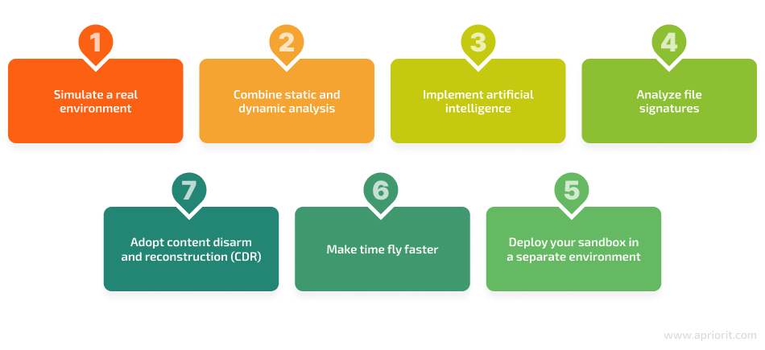
How to Prevent Sandbox Evasion
Notes:
With all the limitation presented in each evasion techniques, sandboxes can be improved and implement security solutions to address sandbox evasion.
Simulate a Real Environment: Use hardware information and dynamic analysis to mimic a real user environment, as modern malware can detect virtual machines. Adjusting sleep duration and analysis time can enhance detection, though it requires more time.
Combine Static and Dynamic Analysis: Utilize both dynamic analysis (behavioral observation) and static analysis (code examination) to catch malware that uses evasion techniques, like delaying execution. Relying solely on one method is insufficient.
Implement Artificial Intelligence: AI can enhance sandboxing by simulating user behavior and identifying zero-day threats, adapting to new evasion techniques, and analyzing file behavior.
Analyze File Signatures: Use signature-based detection to identify known malware. However, for dynamic threats, employ checksumming to verify file integrity and detect changes.
Adopt Content Disarm and Reconstruction (CDR): CDR removes suspicious code from files based on system policies, providing sanitized documents. This can prevent malware in files but risks corrupting legitimate scripts.
Make Time Fly Faster: Adjust the VM's time settings to trick time-evading malware into executing its code when the sandbox is active, helping detect threats that delay execution.
Deploy Your Sandbox Separately: To prevent malware from breaching your main environment, use a separate deployment for the sandbox, such as cloud or remote endpoints, ensuring added security.

Slide 46
Conclusion: Future of Sandbox
Network sandboxes have evolved from basic detection tools to sophisticated systems capable of dynamic analysis and real-time threat monitoring. As threats continue to evolve, the future promises further advancements through AI integration, automation, cloud computing, and collaborative intelligence to stay ahead of malicious actors and protect systems effectively.
Innovation Sandbox for AI: A test environment for implementing AI projects, conducted by Zurich Technopark, promotes responsible innovation by enabling public administration and organizations to collaborate on regulatory issues and utilize new data sources.
The network sandboxing market revenue totaled US$ 7.1 Billion in 2021. The total network sandboxing market size is expected to reach US$ 34.9 Billion by 2032, growing at a CAGR* of 15.7% over the forecast period.
Notes:
*CAGR: Compound Annual Growth Rate

Slide 47
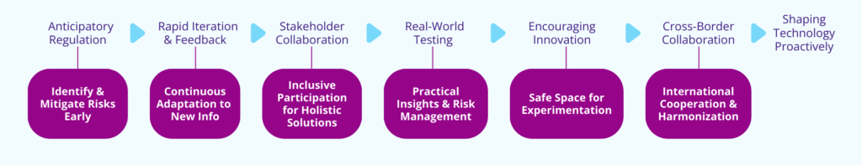
FUTURE OF SANDBOX: Proactive Technology Shaping with Sandboxes
Transitioning from a reactive to a proactive approach in technology requires a paradigm shift in regulation and innovation. Sandboxes provide a powerful tool for this shift, enabling anticipatory regulation, iterative feedback, stakeholder collaboration, real-world testing, public sector innovation, and international cooperation to harness technology's full potential.
By embracing the sandbox approach, we transition from scrambling to keep pace with technology to confidently guiding its development in ways that benefit society, the economy, and innovation.

Slide 48
References
https://csrc.nist.gov/glossary/term/sandbox
https://www.fortinet.com/resources/cyberglossary/what-is-sandboxing
https://www.crowdstrike.com/cybersecurity-101/secops/cybersecurity-sandboxing/
https://www.vmray.com/sandbox-evasion-techniques/
https://research.checkpoint.com/2022/invisible-cuckoo-cape-sandbox-
https://www.makeuseof.com/how-network-two-virtual-machines-with-virtualbox/
https://www.forbes.com/councils/forbestechcouncil/2022/03/16/does-sandboxing-have-a-future/
https://www.apriorit.com/dev-blog/545-sandbox-evading-malware
https://evasion.tymyrddin.dev/docs/sandbox/techniques#geolocation-and-geoblocking
https://votiro.com/blog/5-sandbox-evasion-techniques-tricks/
https://www.nakivo.com/blog/virtualbox-network-setting-guide/
https://www.virtualbox.org/manual/ch01.html#gui-virtualboxmanager
https://docs.oracle.com/en/virtualization/virtualbox/6.0/user/virt-why-useful.html#:~:text=Oracle%20VM%20VirtualBox%20enables%20you,to%20reboot%20to%20use%20it.
https://www.hornetsecurity.com/en/blog/sandbox-environment/
https://www.zh.ch/en/wirtschaft-arbeit/wirtschaftsstandort/innovation-sandbox.html

