Slide 1
K-Anonymization: A Comparative Analysis of MinGen and Greedy Algorithms
Maria Isabel German | Achu Mary Philip | Kamaldeep Kaur
January 31, 2025

Slide 2
Introduction
Definition and Overview of K-Anonymization,
Greedy Algorithm and Minimal Generalization

Slide 3
K-Anonymization Overview
K-Anonymization is a technique used to ensure privacy in datasets by modifying the data so that each record is indistinguishable from at least 𝑘−1 other records with respect to certain quasi-identifiers (e.g., age, gender, zip code). The goal is to protect sensitive information while still maintaining the utility of the data for analysis.

Slide 4
Key Concepts
Quasi-Identifiers
Generalization
Attributes like age, zip code, etc., that can be used to identify individuals when combined.
Modifying the values of quasi-identifiers (e.g., turning exact age values into age ranges).
K-Anonymity
Suppression
A dataset is 𝑘-anonymous if, for each combination of values in the quasi identifiers, there are at least 𝑘 records that share that combination.
Removing certain values to make the data less specific.

Slide 5
Algorithms for K-Anonymization
There are several algorithms for achieving K-anonymity. This teaching aid focuses on two prominent algorithms: MinGen (Brute Force) and Greedy. We will compare both algorithms based on their characteristics, steps, advantages, and limitations.

Slide 6
MinGen Algorithm for K-Anonymization
MinGen (Brute Force Approach) is an algorithm that explores every possible generalization of the dataset to achieve K-anonymity.
Unlike the greedy approach where generalization might go beyond the minimum required to satisfy k-anonymity, MinGen tries to minimize the amount of information lost during the anonymization process.
This method ensures the most accurate anonymization but is computationally expensive.
Notes:
MinGen aims to find the smallest level of generalization that ensures that each group of records with the same values for the quasi-identifiers contains at least k records.

Slide 7
Steps of MinGen Algorithm
1
2
3
4
Start with the original data and identify Quasi-Identifiers. Select the columns that need to be anonymized
For each quasi-identifier, generate all possible generalizations or hierarchies.
For each set of generalizations, check whether the resulting data satisfies k-anonymity (e.g., each record is indistinguishable from at least k-1 others).
Select the minimal solution: the least amount of information loss (smallest generalization) is selected.

Slide 8
MinGen Algorithm Example
Dataset
Assume Age and Zipcode are quasi-identifiers, and aim to satisfy k=3 anonymity
Name | Age | Zipcode | Disease
A | 30 | 12345 | Flu
B | 30 | 12346 | Cold
C | 25 | 12345 | Cancer
D | 25 | 12345 | Flu
E | 35 | 12345 | Cancer
F | 25 | 12346 | Cold

Slide 9
MinGen Algorithm Example
Step 1: Identify the quasi-identifiers:
Age and Zipcode are the quasi-identifiers.
Ensure that for any combination of age and zipcode, there are at least 3 records.
Identify the combinations of age and zipcode in the original dataset.
(30, 12345) appears 1 time (record A).
(30, 12346) appears 1 time (record B).
(25, 12345) appears 2 times (records C, D).
(35, 12345) appears 1 time (record E).
(25, 12346) appears 1 time (record F).
Notes:
None of the combinations meets the k = 3 requirement. Therefore, we need to generalize or suppress some values.

Slide 10
MinGen Algorithm Example
Step 2: Generalization/Suppression Options
Assume the following options to generalize or suppress:
Age can be generalized into ranges:
20-40
20-30
30-40
Zipcode can be generalized into patterns:
1234* (for any zipcode starting with 1234)

Slide 11
MinGen Algorithm Example
Step 3: Enumerate possible generalization
Case 1: Generalize age to 20-40 and zipcode to 1234*
Age: 20-40
Zipcode: 1234*
Name | Age | Zipcode | Disease
A | 20-40 | 1234* | Flu
B | 20-40 | 1234* | Cold
C | 20-40 | 1234* | Cancer
D | 20-40 | 1234* | Flu
E | 20-40 | 1234* | Cancer
F | 20-40 | 1234* | Cold
Notes:
Consider the generalization options for the dataset and check which ones ensure k-anonymity.
Try different combinations of generalizations and verify if we meet the k=3 requirement.
For Case 1: This means that all ages will be generalized to the range 20-40, and all zipcodes will be generalized to the pattern 1234*. The dataset after this generalization has the following combinations:
(20-40, 1234*) appears 6 times (which satisfies k=3).

Slide 12
MinGen Algorithm Example
Step 3: Enumerate possible generalization
Case 2: Generalize age and zipcode
Age: 20-30, 30-40
Zipcode: 1234*
Name | Age | Zipcode | Disease
A | 30-40 | 1234* | Flu
B | 30-40 | 1234* | Cold
C | 20-30 | 1234* | Cancer
D | 20-30 | 1234* | Flu
E | 30-40 | 1234* | Cancer
F | 20-30 | 1234* | Cold
Notes:
Check the combinations:
Both age groups (20-30 and 30-40) have 3 records each, satisfying the k=3 anonymity
This combination also meets the k-anonymity requirement.

Slide 13
MinGen Algorithm Example
Step 4: Evaluate the Results
All the cases considered satisfy k-anonymity. However, we want to minimize information loss:
Case 1: The loss of information due to the broad generalization of Age and Zipcode makes this dataset less useful for analysis. It sacrifices data specificity for anonymity.
Case 2: By keeping two age ranges and generalizing only the Zipcode, it retains more detailed information while still achieving k-anonymity, making it more useful for tasks like research or predictive modeling.
MinGen Result: Case 2, as it preserves more detailed information while achieving k-anonymity.

Slide 14
Greedy Algorithm for K-Anonymization
The Greedy Algorithm is a heuristic approach that aims to iteratively select the best possible generalization or suppression to meet the 𝑘-anonymity requirement. It chooses actions based on a local optimal strategy at each step.
Notes:
Instead of evaluating every possibility like MinGen, it makes decisions step by step.

Slide 15
Steps of Greedy Algorithm
1
2
3
4
5
Sort the records based on quasi-identifiers.
For each record, check if it satisfies the 𝑘-anonymity condition.
Generalize the quasi-identifiers (e.g., replace exact values with ranges) to increase the number of records sharing the same value.
If generalization alone is insufficient, suppress certain values.
Repeat until the dataset satisfies 𝑘-anonymity for all quasi-identifiers.

Slide 16
Greedy Algorithm Example
Dataset
Assume Age and Zipcode are quasi-identifiers, and aim to satisfy k=3 anonymity
Name | Age | Zipcode | Disease
A | 30 | 12345 | Flu
B | 30 | 12346 | Cold
C | 25 | 12345 | Cancer
D | 25 | 12345 | Flu
E | 35 | 12345 | Cancer
F | 25 | 12346 | Cold
Notes:
Quasi-identifiers (age and zipcode)

Slide 17
Greedy Algorithm Example
Step 1: Sort by Age and Zipcode:
Name | Age | Zipcode | Disease
C | 25 | 12345 | Cancer
D | 25 | 12345 | Flu
F | 25 | 12346 | Cold
A | 30 | 12345 | Flu
B | 30 | 12346 | Cold
E | 35 | 12345 | Cancer

Slide 18
Greedy Algorithm Example
Step 2: Check combinations:
(25, 12345) occurs 2 times, which is less than 3.
(25, 12346) occurs 1 time, which is less than 3.
(30, 12345) occurs 1 time, which is less than 3.
(30, 12346) occurs 1 time, which is less than 3.
(35, 12345) occurs 1 time, which is less than 3.

Slide 19
Greedy Algorithm Example
Step 3: Generalize/Suppress:
(25, 12345): Generalize age=25 to age=20-40 and zipcode=12345 to zipcode=1234* to form a wider group.
(25, 12346): Generalize age=25 to age=20-40 and zipcode=12346 to zipcode=1234*.
(30, 12345): Generalize age=30 to age=20-40 and zipcode=12345 to zipcode=1234*.
(30, 12346): Generalize age=30 to age=20-40 and zipcode=12346 to zipcode=1234*.
(35, 12345): Generalize age=30 to age=20-40 and zipcode=12346 to zipcode=1234*.

Slide 20
Greedy Algorithm Example
Step 4: Repeat until k-anonymity is satisfied:
Name | Age | Zipcode | Disease
C | 20-40 | 1234* | Cancer
D | 20-40 | 1234* | Flu
F | 20-40 | 1234* | Cold
A | 20-40 | 1234* | Flu
B | 20-40 | 1234* | Cold
E | 20-40 | 1234* | Cancer
Notes:
All combinations are generalized to satisfy k=3 and the datasets meets k-anonymity (each combination of age and zipcode appears at least 3 times).
In this case, the Greedy algorithm worked efficiently to achieve 3-anonymity, but the solution involve more generalization than the Brute Force approach have found.

Slide 21
Implementation
Comparative analysis of MinGen Brute Force vs. Greedy Approach for k-Anonymization
Notes:
The team have created a basic python code to illustrate MinGen and Greedy algorithm workflow and processes. The program code, attached separately, also aims to compare time completion of both algorithms for small and large datasets.

Slide 22
Implementation Overview
Data Preparation (Small and Large Datasets)
Applying MinGen Brute Force Algorithm
Applying Greedy Algorithm
Measuring Execution Time and Certainty Metric Value
Notes:
Comparing results for the following datasets:
Small dataset consists of 10 records
Large dataset consists of 30 records

Slide 23
MinGen Brute Force Workflow
The MinGen Brute Force algorithm tests all possible generalization combinations to achieve optimal k-anonymity, ensuring minimal information loss. It explores the entire search space without shortcuts.
Input Data
Generate Generalization Combinations
Check k-Anonymity
Output Optimal Solution
Apply Generalization
Calculate Generalization Loss
Track Minimal Generalization
Notes:
Input Data: The dataset is loaded into a pandas DataFrame.
Generate Generalization Combinations : The code iterates over all possible combinations of generalizations using itertools.product.
Apply Generalization: The generalize_data() function modifies each row based on the chosen generalization levels.
Check k-anonymity: Groups are formed based on the generalized quasi-identifiers, and the size of each group is compared to k. The is_k_anonymous() function verifies if the generalized dataset satisfies k-anonymity.
Calculate Generalization Loss: If the dataset satisfies k-anonymity, calculate_loss() function computes the information loss for each generalization.
Track Minimal Generalization: The algorithm keeps track of the generalization with the least information loss.
Output Optimal Solution: After evaluating all combinations, the best generalization that satisfies k-anonymity with minimal information loss is returned.

Slide 24
Greedy Approach Workflow
The greedy algorithm simplifies the process of achieving k-anonymity by iteratively selecting generalizations in a prioritized order, minimizing generalization loss. It stops as soon as a generalization satisfies k-anonymity and aims to minimize generalization loss along the way.
Generate a Priority List of Generalizations
Check k-Anonymity
Iterate Through Generalizations
Input Data
Measure Generalization Loss
Select the Optimal Generalization
Output Results
Notes:
Input Data: The dataset is loaded into a pandas DataFrame.
Generate a Priority List of Generalizations: The gen_comb list defines generalizations in a prioritized order, from the most suppressive to the least.
Iterate Through Generalizations: Apply generalizations step-by-step according to the priority list, modifying the dataset incrementally.
Check k-Anonymity: Evaluate whether the generalized dataset satisfies the k-anonymity requirement at each step. The function is_k_anonymous() is used to verify if the generalized dataset satisfies k-anonymity.
Measure Generalization Loss: The function calculate_loss() computes the information loss for each generalization.
Select the Optimal Generalization: The algorithm stops at the first generalization that satisfies k-anonymity, ensuring minimal information loss.
Output Results: The best generalization found is returned as the final k-anonymized dataset.

Slide 25
Dataset – Employee Salary Data (Small)
Gender | Job Role | Years of Experience | Work Location | Salary
Male | Software Engineer | 4 | Toronto | $85,000
Female | Developer | 3 | Vancouver | $60,000
Male | Sales Manager | 8 | Calgary | $75,000
Female | Financial Analyst | 4 | Montreal | $90,000
Male | IT Support | 2 | Ottawa | $50,000
Female | HR Manager | 5 | Fredericton | $80,000
Male | Sales Executive | 7 | Calgary | $70,000
Female | Accountant | 9 | Edmonton | $95,000
Male | Data Scientist | 3 | Winnipeg | $88,000
Female | Sales Assistant | 1 | Quebec City | $55,000
Notes:
Key Points:
Employees hold various roles across departments like IT, HR, Finance, and Sales.
The dataset includes employees with experience levels ranging from 1 year to 10 years.
The lowest salary is $50,000, while the highest is $95,000, showing a significant variance.
Employees are based in major cities across Canada.
Anonymization Challenges: Distinctive attributes such as specific job roles and locations can make re-identification possible without proper generalization.

Slide 26
MinGen Brute Force vs. Greedy Approach Output (small dataset)
Generalizations used for both algorithm:
Gender: Generalized to “M/F” for all records.
Job Role: Grouped into Technical and Non-Technical categories.
Years of Experience: Categorized into “0-5” and “6-10”.
Work Location: Generalized into "Western Canada" and “Eastern Canada” regions.

Slide 27
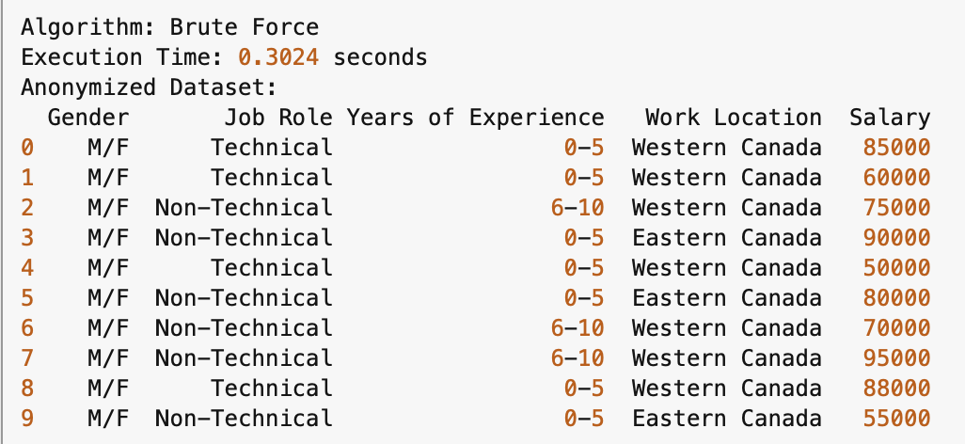
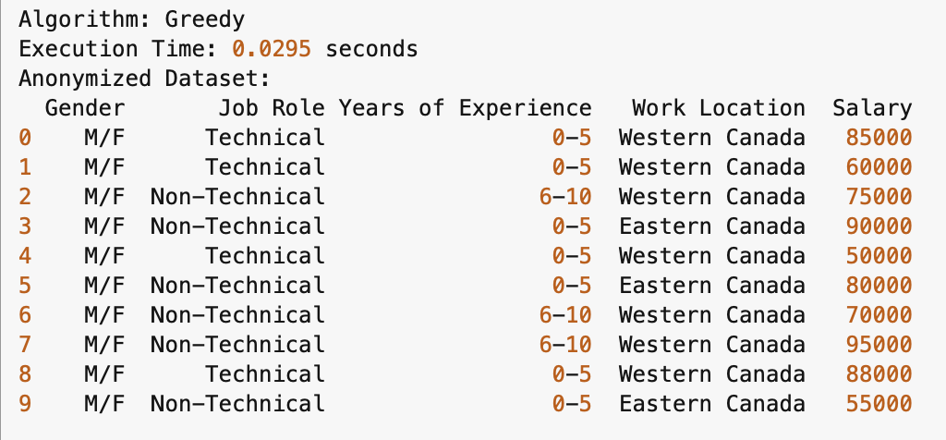
MinGen Brute Force vs. Greedy Approach Output (small dataset)
MinGen Brute Force k-anonymized dataset
Greedy Approach k-anonymized dataset
For k=3
For k=3

Slide 28
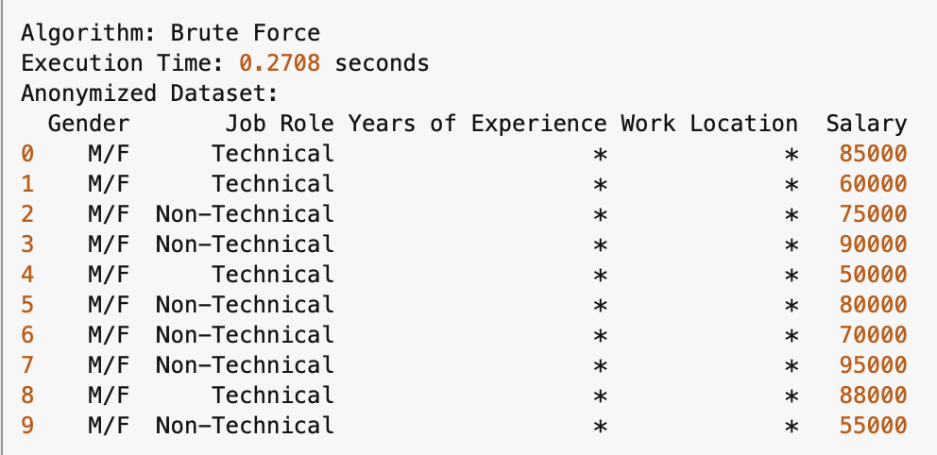
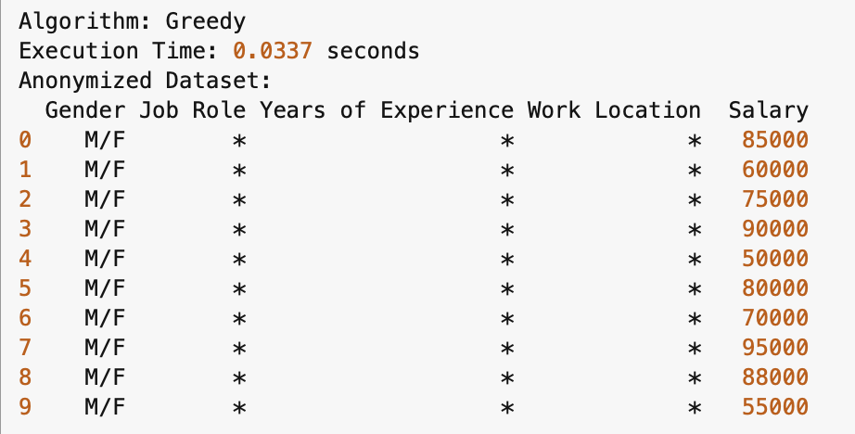
MinGen Brute Force vs. Greedy Approach Output (small dataset)
MinGen Brute Force k-anonymized dataset
Greedy Approach k-anonymized dataset
For k=4
For k=4
Notes:
Brute Force prioritizes minimal information loss but requires longer processing time as shown here.
As k increases, the algorithm exhaustively searches for the best possible generalization, only suppressing when absolutely necessary.
Execution time also increases significantly as k increases because it evaluates all combinations.

Slide 29
Dataset – Employee Salary Data (Large)
Gender | Job Role | Years of Experience | Work Location | Salary
Male | Software Engineer | 5 | Toronto | $85,000
Female | HR Specialist | 3 | Vancouver | $60,000
Female | Sales Manager | 8 | Calgary | $75,000
Male | Financial Analyst | 6 | Montreal | $90,000
Female | IT Support | 2 | Ottawa | $50,000
Female | HR Manager | 4 | Toronto | $80,000
Female | Sales Executive | 7 | Edmonton | $70,000
Female | Accountant | 10 | Halifax | $95,000
Male | Data Scientist | 3 | Winnipeg | $88,000
Female | Sales Assistant | 1 | Quebec City | $55,000
Notes:
Key Points:
Salaries range from $45,000 to $120,000.
Locations include major cities across Canada.
Job roles vary from technical to administrative fields.

Slide 30
Dataset – Employee Salary Data (Large) contd..
Gender | Job Role | Years of Experience | Work Location | Salary
Female | Marketing Manager | 12 | Fredericton | $110,000
Female | Project Manager | 9 | Calgary | $120,000
Male | Business Analyst | 5 | Toronto | $78,000
Female | Operations Manager | 7 | Montreal | $102,000
Female | UX Designer | 4 | Ottawa | $85,000
Female | DevOps Engineer | 6 | Edmonton | $92,000
Male | Administrative Asst | 3 | Winnipeg | $45,000
Male | IT Manager | 11 | Halifax | $115,000
Female | QA Engineer | 5 | Vancouver | $72,000
Male | Customer Service | 2 | Calgary | $48,000

Slide 31
Dataset – Employee Salary Data (Large) contd..
Employee ID | Job Role | Years of Experience | Work Location | Salary
Male | Digital Marketer | 6 | Montreal | $85,000
Male | Security Analyst | 4 | Ottawa | $79,000
Male | Software Developer | 8 | Toronto | $98,000
Male | Payroll Specialist | 5 | Quebec City | $76,000
Female | Cloud Engineer | 7 | Calgary | $105,000
Male | HR Coordinator | 3 | Edmonton | $58,000
Female | Account Executive | 9 | Winnipeg | $115,000
Male | Cybersecurity Eng. | 6 | Vancouver | $102,000
Female | Social Media Mgr | 4 | Calgary | $69,000
Male | Procurement Mgr | 10 | Montreal | $97,000

Slide 32
MinGen Brute Force vs. Greedy Approach Output (large dataset)
Generalizations used for both algorithm:
Gender: Generalized to “M/F” for all records.
Job Role: Grouped into Technical and Non-Technical categories.
Years of Experience: Categorized into “0-5” , “6-10” and “11-15”.
Work Location: Generalized into "Western Canada" and “Eastern Canada” regions.

Slide 33
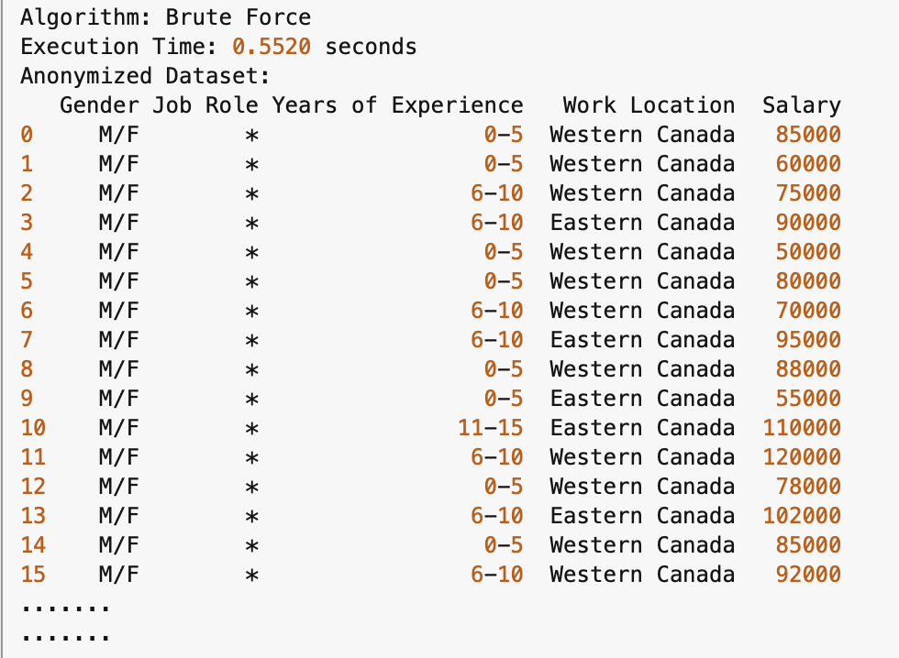
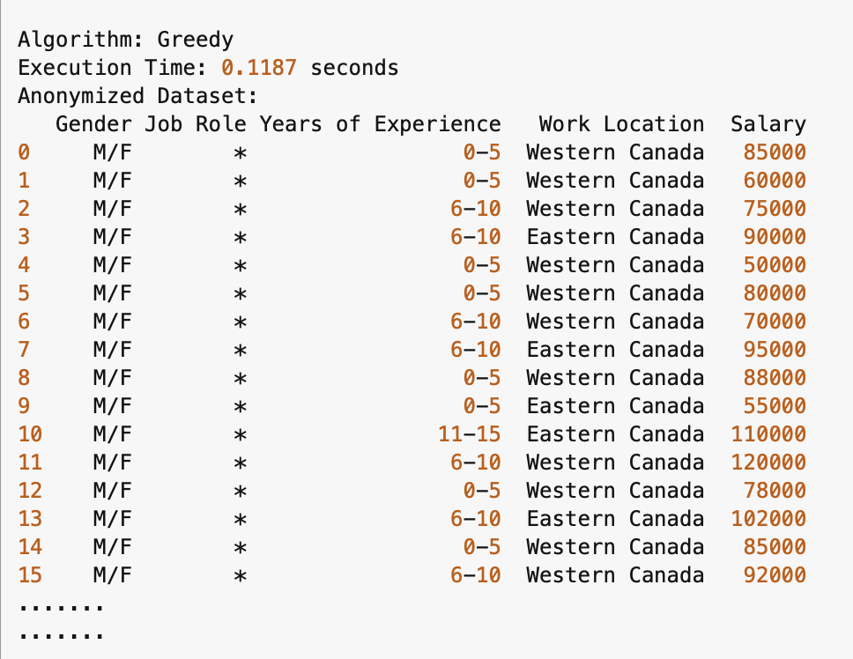
MinGen Brute Force vs. Greedy Approach Output (large dataset)
MinGen Brute Force k-anonymized dataset
Greedy Approach k-anonymized dataset
For k=2
For k=2
Notes:
Greedy prioritizes efficiency by stopping as soon as it finds a valid generalization that meets k=3, potentially leading to suboptimal output.
As k increases, suppression happens more aggressively, potentially leading to more generalization and loss of detail than MinGen.
Execution time does not increase as drastically as MinGen, since it stops once a valid generalization is found.

Slide 34
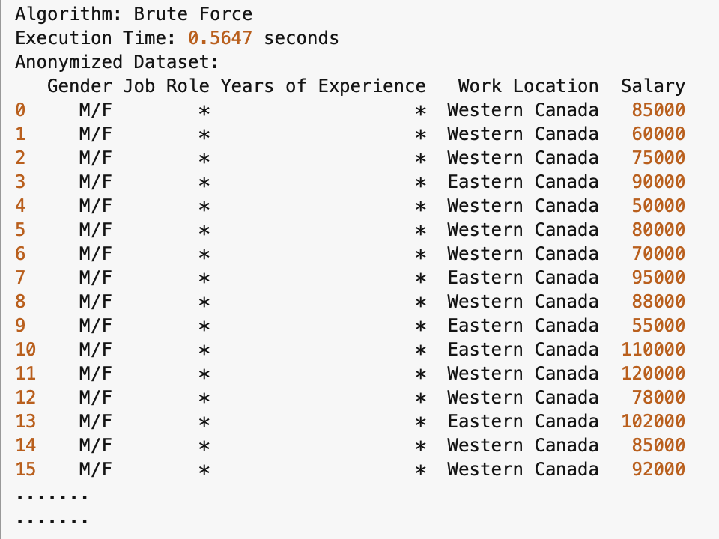
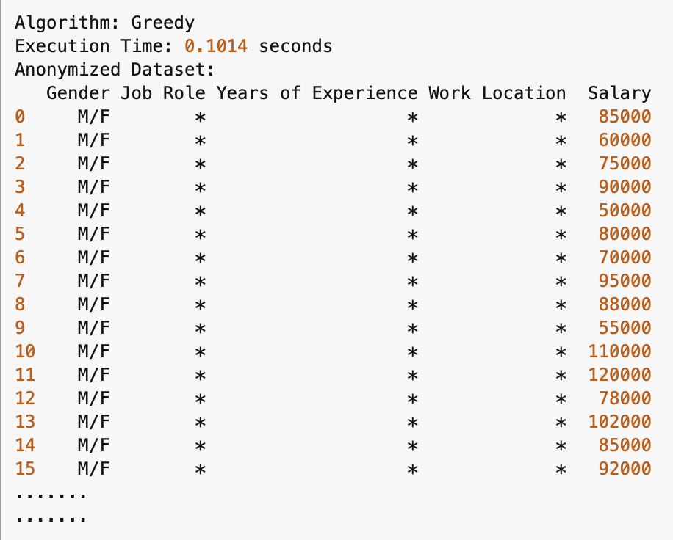
MinGen Brute Force vs. Greedy Approach Output (large dataset)
MinGen Brute Force k-anonymized dataset
Greedy Approach k-anonymized dataset
For k=3
For k=3

Slide 35
Dataset Summary
Total Records: 10 (Small Dataset)
Total Records: 30 (Large Dataset)
Attributes Considered
Quasi-Identifiers
Gender
Job Role
Years of Experience
Work Location
Sensitive Attribute:
Salary

Slide 36
Execution Time Comparison
Notes:
The trend shows that as k increases, execution time remains relatively stable for Greedy, whereas MinGen continues to take longer.
This comparison shows the importance of selecting an anonymization method based on the balance between computation time and data utility.

Slide 37
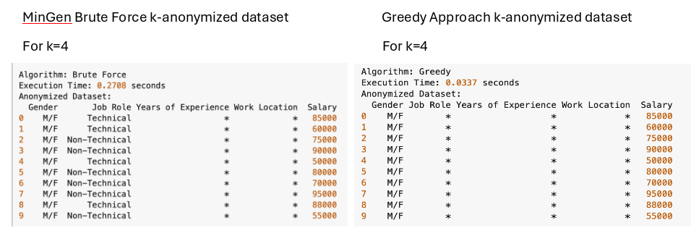
Certainty Metric Value Comparison
Take note:
Lower Score
Higher Score
Notes:
Used small dataset with k=4 for illustration purposes
Gender + Job Role + Years of Experience + Work Location
Calculation for Small dataset
MinGen Certainty Metric Value
10(1/2) + 4(2/10) + 6(2/10) + 10 + 10
27
Greedy Certainty Metric Value
10(1/2) + 10 + 10 + 10
35
Calculation for Large dataset
MinGen Certainty Metric Value
30(1/2) + 30 + 30 + 21(2/10) + 9(2/10)
81
Greedy Certainty Metric Value
30(1/2) + 30 + 30 + 30
105

Slide 38
Analysis

Slide 39
Key Comparison Points:
Criteria | MinGen (Brute Force Approach) | Greedy Algorithm
Complexity | Exhaustive search, higher computational cost | Faster and more efficient, but may make suboptimal choices
Time Completion (Efficiency) | Slower (O(2^n)) | Faster (O(n log n) or O(nk))
Optimality of Solution | Optimal, finds the best solution | May give a good but suboptimal solution
Certainty Metric Value | Lower Score (optimal solution) | Higher Score (less optimal solution)
Efficiency and scalability | Slow for large datasets | Fast and scalable for larger datasets
Data Loss | Minimal loss (since it aims for optimal solution) | Can lead to higher information loss in some cases
Notes:
Time Completion (Efficiency)
Greedy Algorithm:
The greedy algorithm is generally more efficient and faster. Its time complexity is typically O(n log n) or O(nk), where n is the number of records and k is the desired anonymity level. Greedy algorithm makes local, optimal choices at each step, trying to find a solution in a more iterative, progressive manner. Typically scans through the data a limited number of times.
Tends to perform well for larger datasets, as it avoids exploring all potential combinations and focuses on making a good-enough solution quickly.
Greedy algorithm may provide relatively less favorable solutions, its complexity is much less dependent on the number of attributes and is bounded by O(n2) regardless of the choice of k.
MinGen (Brute Force) Algorithm:
MinGen algorithm, using a brute-force approach, is much slower. It has an exponential time complexity, typically O(2^n), as it must examine all possible combinations of records to find the optimal solution.
This is inefficient for large datasets since the algorithm must explore a huge number of possible subsets of records, making it impractical for large-scale problems. In small-scale datasets, it can work but still takes significantly longer compared to the greedy approach.
Certainty Metric Value
The certainty metric value measures the accuracy loss or information loss due to the anonymization process. Lower scores indicate less information loss and thus a more efficient anonymization.
Greedy Algorithm:
The greedy algorithm often results in a higher certainty metric value than the brute-force approach because it does not always guarantee the optimal solution. It aims for a fast solution, it may make compromises on data utility (e.g., grouping too many records together). This leads to less optimal anonymization in some cases, meaning more information loss.
There is a trade-off between speed and the quality of anonymization. While the solution might not always be perfectly optimal, it can still achieve a reasonably good level of anonymization with a reasonably low metric value.
MinGen (Brute Force) Algorithm:
Since MinGen evaluates all possible combinations and solutions, it is guaranteed to find the optimal anonymization with the lowest possible certainty metric value. It minimizes information loss as much as possible while ensuring k-anonymity.
The optimal solution comes at the cost of time. Although the certainty metric value will be low (indicating minimal data distortion), this advantage is countered by the inefficiency and impracticality of applying the brute-force approach to large datasets.

Slide 40
Advantages and Disadvantages
Algorithm | Advantages | Disadvantages
MinGen (Brute Force) | Theoretically produces the optimal solution in terms of generalization. | Computationally expensive for large datasets due to the brute force nature. Inefficient as it doesn’t scale well when the dataset size increases
Greedy | Faster and more scalable than the MinGen algorithm. Produces a good (but not necessarily optimal) solution with much lower computational cost. | May not always produce the most optimal result. The greedy choice does not always lead to a global optimum.

Slide 41
Conclusion

Slide 42
LET’S RECAP:
MinGen (Brute Force) Approach:
Explores all possible k-anonymity solutions, ensuring minimal suppression and better data utility.
More accurate but computationally expensive as k increases.
Greedy Algorithm:
Makes quick choices, leading to faster execution but potentially higher suppression.
Prioritizes efficiency over precision, which can result in greater data loss
Key Trade-offs:
MinGen Better data utility but longer execution time.
Greedy Faster but with potentially higher suppression and information loss.

Slide 43
The choice between MinGen and Greedy depends on the priorities of the task at hand. MinGen is better suited for situations where data utility is critical, as it minimizes unnecessary suppression, though at the cost of longer execution times.
On the other hand, Greedy is ideal for scenarios where speed is a priority, but it may result in more aggressive generalization and data loss.
Ultimately, the decision should be based on the balance between privacy, computational efficiency, and the acceptable level of data distortion for the specific application.

Slide 44
References
https://www.hackerearth.com/practice/algorithms/greedy/basics-of-greedy-algorithms/tutorial/#:~:text=A%20greedy%20algorithm%2C%20as%20the,to%20a%20globally%2Doptimal%20solution
https://www.geeksforgeeks.org/applications-advantages-and-disadvantages-of-greedy-algorithms/
K-Anonymization as Spatial Indexing: Toward Scalable and Incremental Anonymization. https://www.vldb.org/conf/2007/papers/research/p746-iwuchukwu.pdf
Optimization-Based k-Anonymity Algorithms https://www.ee.torontomu.ca/~samavi/preprints/LiangSamavi_Anonymization_MILP_preprint.pdf

